Slide 1
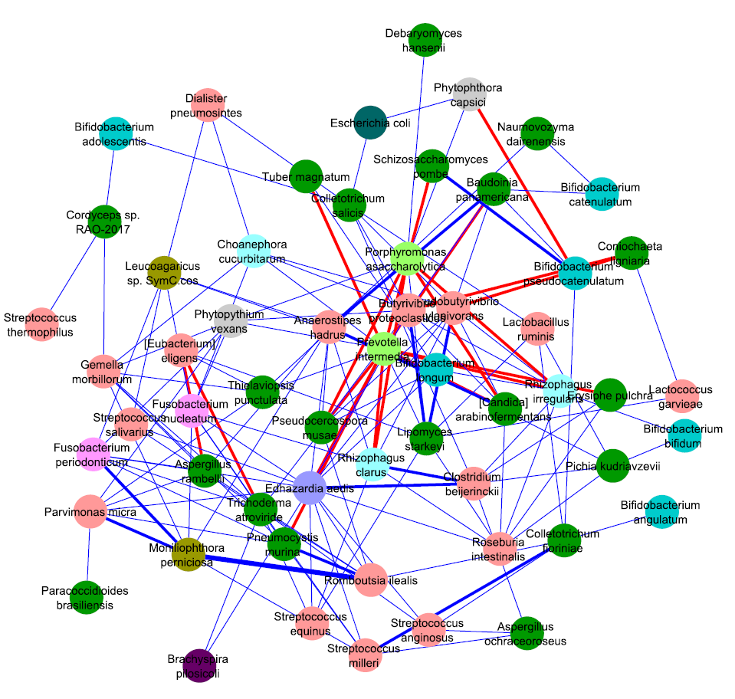
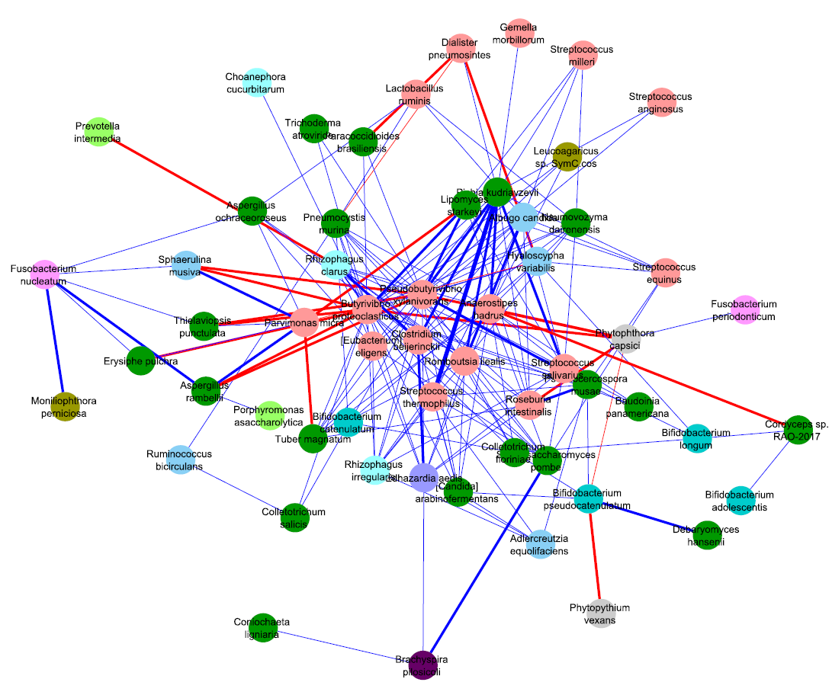
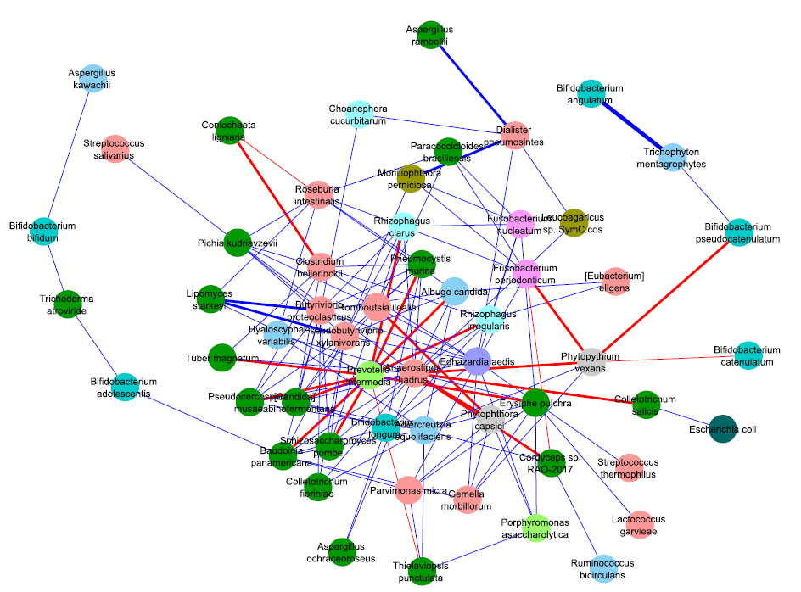
CRC group
Healthy control
Adenoma
Actinobacteria
Firmicutes
Proteobacteria
Ascomycota
Fusobacteria
Spirochaetes
Bacteroidetes
Microsporidia
Unknown
Basidiomycota
Mucoromycota
S figure 5 Correlation networks of colorectal cancer associated fungi-bacteria with disease progression. Correlation strengths were estimated by DCGA algorithm. For visualization, significant relationships with a p-value less than 0.05 were kept. Distinct phyla were represented by different colored nodes. The blue and red edges, respectively, represented positive and negative correlations. The correlation strength was indicated by the width of the edge.

